Slide 1



IDEATHON 2K23
TEAM: "YODHA"
1.K SAI VAISHNAVI REDDY
2.B.SHIVANI
3.K POOJA CHOWDARY
4.P.SIRI
5.G BHANUSHA
6.K AKHILA

Slide 2

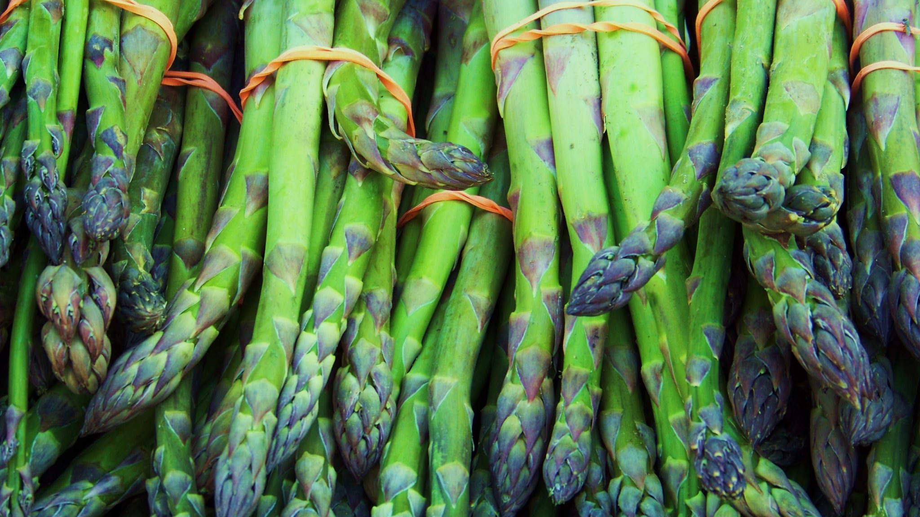
AGRI CHAIN

Slide 3
INTRODUCTION
PROBLEM STATEMENT:
Consumers, who buy organic food, have expectations about its quality and rely on certifying organizations to verify this quality as well as to provide information about the origin of organic products. However, organic food traceability has several issues, such as problems with organic labeling, certification fraud, and concerns about transparency of food information.

Slide 4
SOLUTION
To overcome this problem, we came up with this idea by using blockchain technology.
A producer collects all the proofs in every stage of harvesting and submits it to a food inspector.
Food inspector verifies the proof at every individual stage. Then producer divides them into batches and sets an harvest id to upload the details in to the block chain.
We can track the organic product details by using harvesting id from the farmer to end users(customers).

Slide 5
When a Customer is willing to buy the product, checks with the harvest id (it gives the information about the origin of the product) then decides whether to buy the product or not.
The farmer will update all the three stages of information in the blockchain.
Later the inspector will verify whether the information posted by the farmer at every stage.
After verification of three stages by the inspector, the farmer will update the status of product along with destination store.

Slide 6
FABRIC COMPONENTS
PEERS: 1.Farmer
2.Inspector
3.stores
LEDGER:
Create a harvest record
Update the record

Slide 7
.
ORGANIC PRODUCT
Unique id | Harvest id | Type | Image url | Stage
01 | 15432 | Millets- | farning images http link - Google Search | Stage 1
02 | 15432 | millets | farming images - Google Search | Stage 2
03 | 15432 | millets | farming images - Google Search | Stage 3
Name of the store
_
_
Jaya stores

Slide 8
Pseudo code
STEP 1:Farmer will post the information about the crop in blockchain in three different stages.
STEP 2:The inspector will verify whether the given information is valid or not.
STEP 3:After the verification by the inspector at three different stages then a farmer will produce an ID.
STEP 4:The customer will get the product with harvest ID.
STEP 5:By using ID we can trace whether the product is organic or not.

Slide 9

HIGHLEVEL FLOW
s1
s1
farmer
Inspector
s1
stores
N
L1
L1
L1
Ordering service
Channel

Slide 10
SMART CONTRACT
Code for smart contractor:
Product_insertion :
Insert(Harvest id)
{
Unique id;
Type;
Image url;
Stage;
Name of the store;
}
​verification process
find(Harvest_id )​
{​
Product_details=get(Harvest_id )​
If(product_details !=null)​
Return product_details;​
Else ​
Return "fake product";​

Slide 11
INSPECTION:
Verify(Harvest id)
{
Unique id;
Type;
Image url;
Stage;
Name of the store;
}

Slide 12
CONCLUSION
Hence by using this platform we can develop trust between the farmer and the customer and also reduce the inorganic food.
"organic products are best from nature and best for nature"

Slide 13
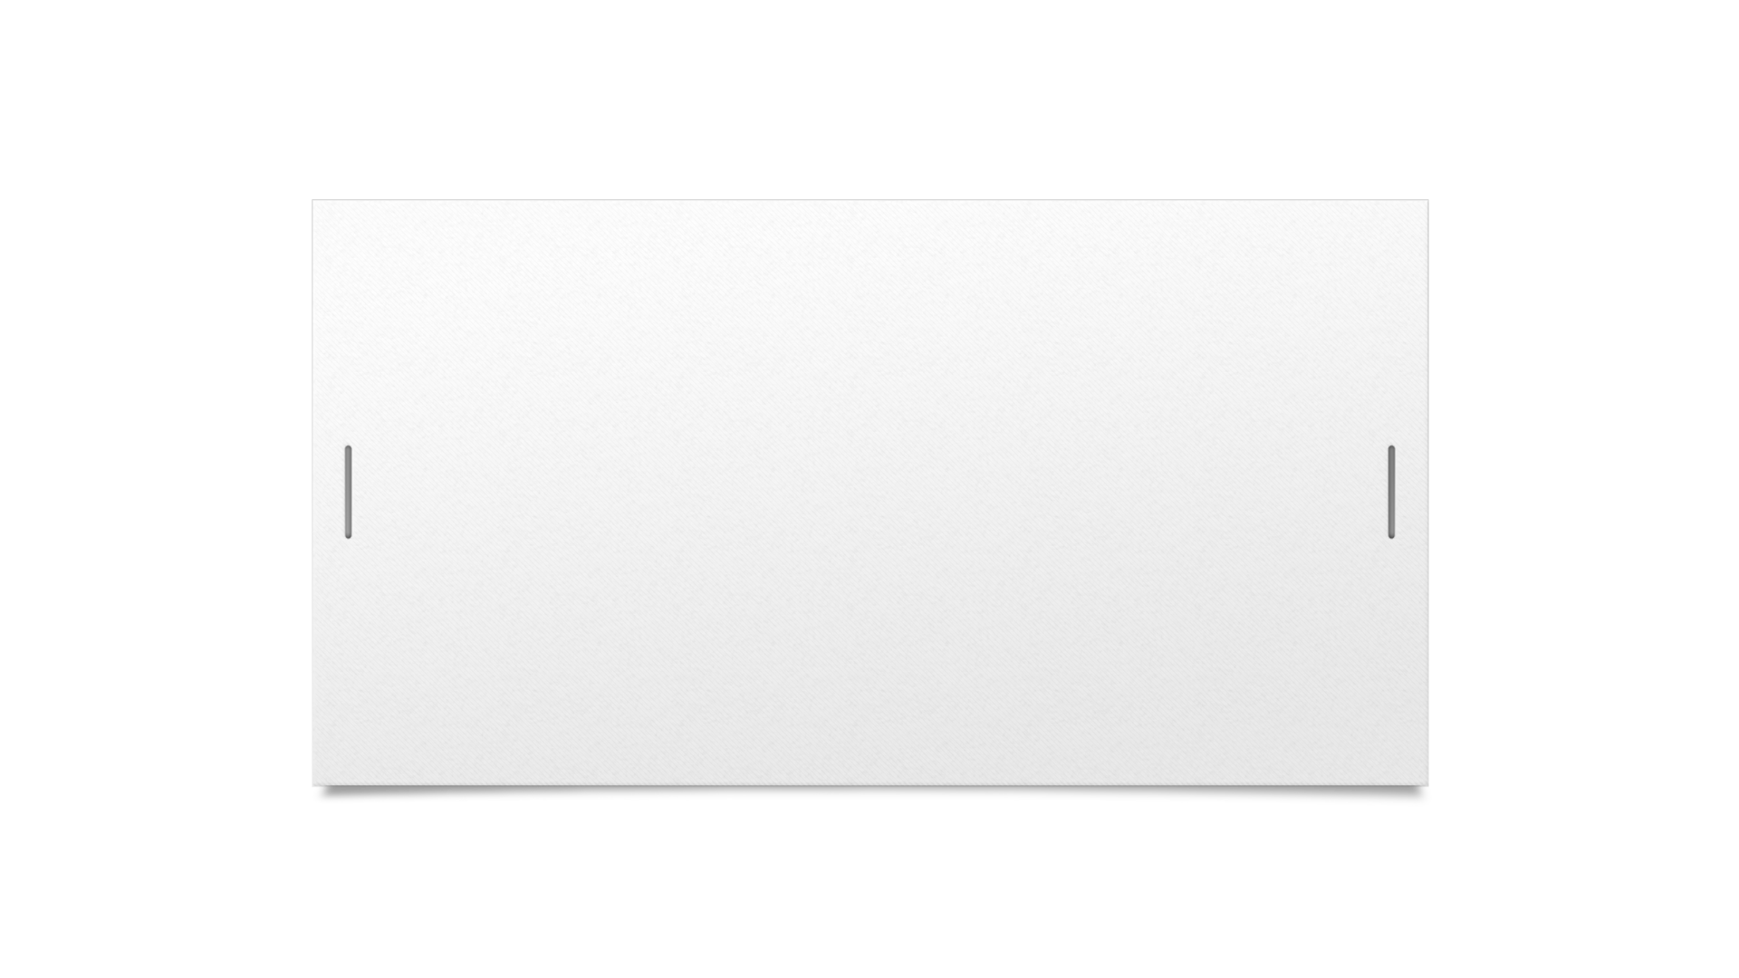

THANK YOU

